Slide 1

AGB1211 – DESIGN THINKING
Department of Artificial Intelligence and Data Science
Academic Year: 2024 – 2025 (Odd Semester)
Year :II
Semester :III
Section :B
Date :06/12/12
PRESENTED BY GUIDED BY
1. SURYA S (2303811724321115) JOANY FRANKLIN M.E.,
2.THILIP KUMAR S (2303811724321117) Assistant Professor,
3.VAITHYANADHAN S G (2303811724321119) Department of AI,
K.Ramakrishnan College of Technology

Slide 2
Title of the Project
HOUSEHOLD WASTE MANAGEMENT
SYSTEM

Slide 3
Problem Identification
Inefficient waste collection leads to unorganized waste disposal.
Improper disposal of waste causes environmental pollution.
Loss of valuable recyclable materials.
Improper disposal of waste causes environmental pollution.
Lack of proper infrastructure for managing household waste.

Slide 4
Objective
The primary objective of this household waste management system project is to design and implement an efficient, sustainable, and community-driven waste management system that minimizes environmental pollution and health risks. The system aims to optimize waste collection, segregation, and disposal processes, while also promoting recycling, reducing waste sent to landfills, and increasing public awareness and participation in proper waste management practices.Also collect feedback from users and house holders to refine the design and functionality.

Slide 5
BrainStorming
SAMPLE KEYWORDS:
Organic waste
Inorganic waste
Education & awareness
Hazardous waste
Recycling center
Waste collection
Landfill

Slide 6
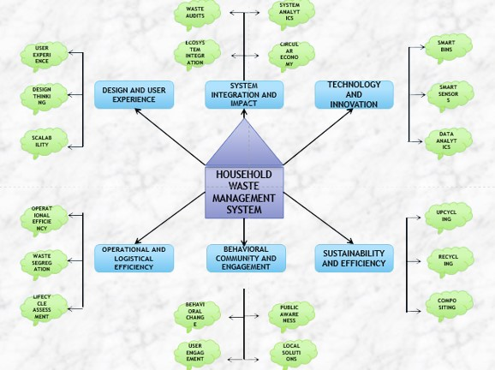
Mind Map

Slide 7
Primary Research
Interviews: Conducting Surveys and Questionnaires, Distributing structured forms to households to gather insights on their waste disposal habits.
One-on-one discussions: With residents, waste workers, or local authorities about waste management challenges.
Observations: Monitoring waste collection processes or household waste segregation practices in real-time.
Case Studies: Examining specific neighborhoods or communities to explore their waste management systems in detail.

Slide 8
Secondary Research
Government Reports: Data on municipal waste management practices and policies.
Academic Research: Studies and articles on waste management systems and their challenges.
Online Databases: Statistics and trends related to waste generation and disposal.
Media Articles: News articles or features discussing waste management issues in various regions.

Slide 9
Proposed Work
The project involves developing an interactive prototype for a Household Waste Management System aimed at addressing issues such as inefficient waste collection, lack of public awareness, and insufficient recycling infrastructure. The goal is to design an intuitive, user-friendly system that facilitates better waste management practices, including waste segregation, collection scheduling, and recycling tracking. The work will involve researching existing waste management systems, creating a functional prototype using Figma, conducting user testing to gather feedback, and refining the design based on that input. The final deliverable will be an interactive prototype ready for presentation to stakeholders, with a roadmap for further development and implementation.

Slide 10
List of Modules
COLLECTION OF DATA MODULE
WASTE PROCESSING AND PREVENTION MODULE
DASHBOARD MODULE
DISPOSAL AND FEEDBACK MODULE

Slide 11
Module 1 Description
COLLECTION OF DATA MODULE
This module focuses on waste collecting data from the household level and encourages proper segregation of waste into categories such as Organic, Inorganic, and Hazardous waste. It may include the use of separate bins to guide households in segregating their waste correctly. dule one slide

Slide 12
Module 2 Description
WASTE PROCESSING AND PREVENTION MODULE
This module focuses on preventing environmental harm by efficiently processing waste at central facilities. It includes measures for composting organic waste, inorganic waste, and hazardous waste. The use of advanced technologies such as biogas plants or waste-to-energy systems helps reduce the volume of waste and prevent pollution, promoting a cleaner, more sustainable environment.

Slide 13
Module 3 Description
DASHBOARD MODULE
The dashboard module provides an overview of the entire system, giving users access to key features and insights. It includes sections for tracking waste collection schedules, monitoring recycling progress, receiving notifications, and viewing feedback or reports. Users can also access waste segregation tips and track their activity. For administrators, the dashboard offers analytics to assess system performance and tools to manage user engagement and education progress efficiently.

Slide 14
Module 4 Description
DISPOSAL AND FEEDBACK MODULE
This module handles to helps users manage waste effectively by providing disposal guidelines for biodegradable, recyclable, and hazardous materials while tracking activities. It also allows users to report issues, give ratings, and suggest improvements, ensuring better waste management and continuous system improvement.

Slide 15
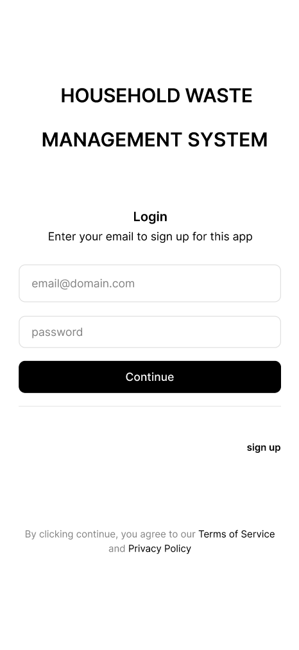
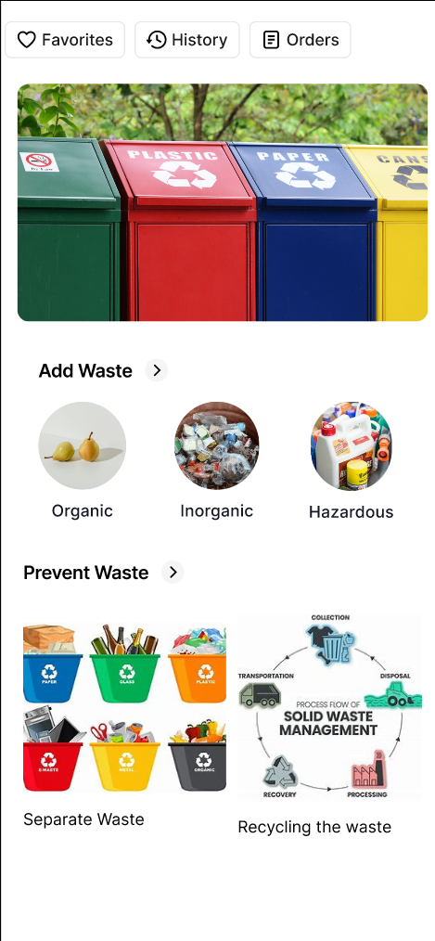
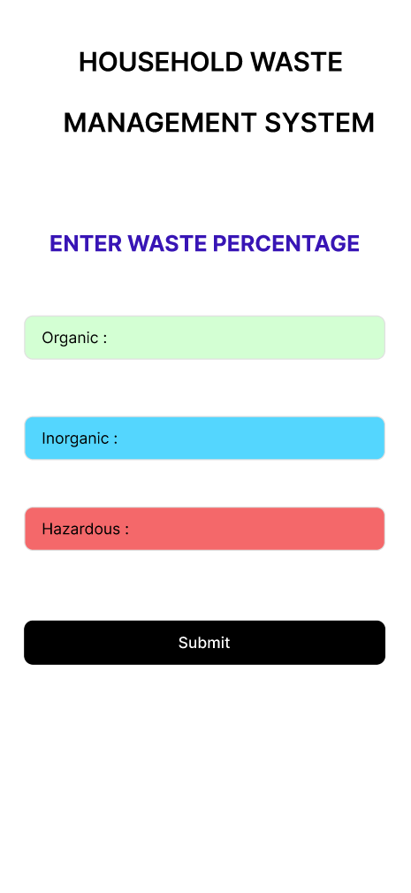
Results

Slide 16
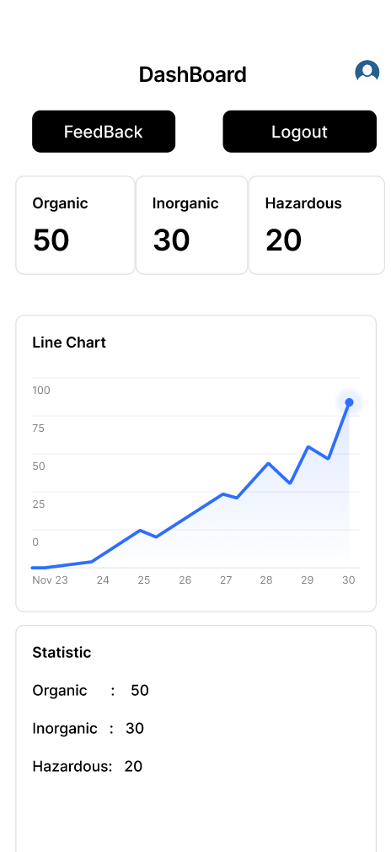
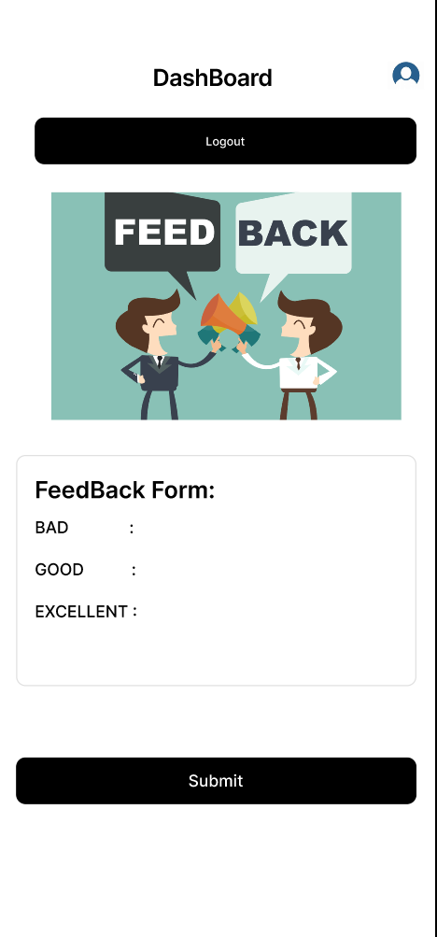
Results

Slide 17
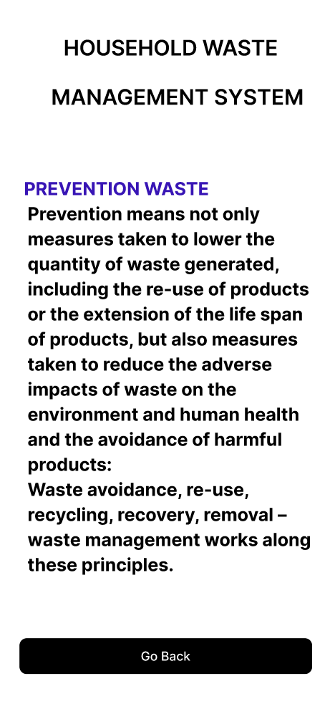
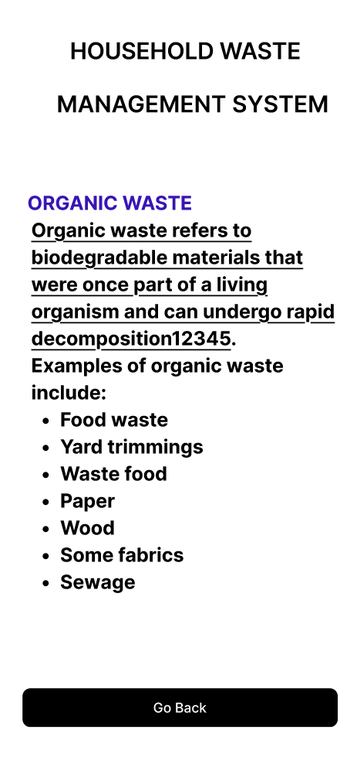
Results

Slide 18
Conclusion
The household waste management system aims to provide an efficient and user-friendly solution to address waste collection, segregation, recycling, and disposal challenges. By integrating features like scheduling, tracking, and public awareness, the system promotes sustainable practices and reduces environmental impact. This project emphasizes the importance of proper waste management while ensuring user convenience and encouraging active participation for a cleaner and healthier environment.

Slide 19
Thank You
Any queries???

